Slide 1
Grice Marine Laboratory
Safety Training Class
Greg Townsley – Lab Manager
townsleyjg@cofc.edu
843-953-9174

Slide 2
Outline:
Lab safety guidelines
Knowing the risks by understanding:
Globally Harmonized System (GHS) of classification and labeling of chemicals
Safety Data Sheets (SDSs) – What they contain
Hazard communication symbols and pictograms – What they mean
Minimizing the risks by:
Following standard operating procedures (SOPs)
Wearing personal protective equipment (PPE) and using engineering controls
Following general lab rules and prudent practices
Understanding Chemical Hygiene Plan (CHP)
Working with specific types of hazards
Chemical, Biological, Radioactive, Physical, Electrical, Mechanical
Safety in the field
Emergency Response Procedures

Slide 3
Knowing the Risks: GHS, SDSs and Labelling

Slide 4
GHS – Globally Harmonized System of Classification and Labelling of Chemicals
Internationally recognized system created by the United Nations.
A standardized system through which chemical hazards are identified and communicated to all who may be potentially exposed.
Simplified Safety Data Sheets
Standardized chemical labelling

Slide 5
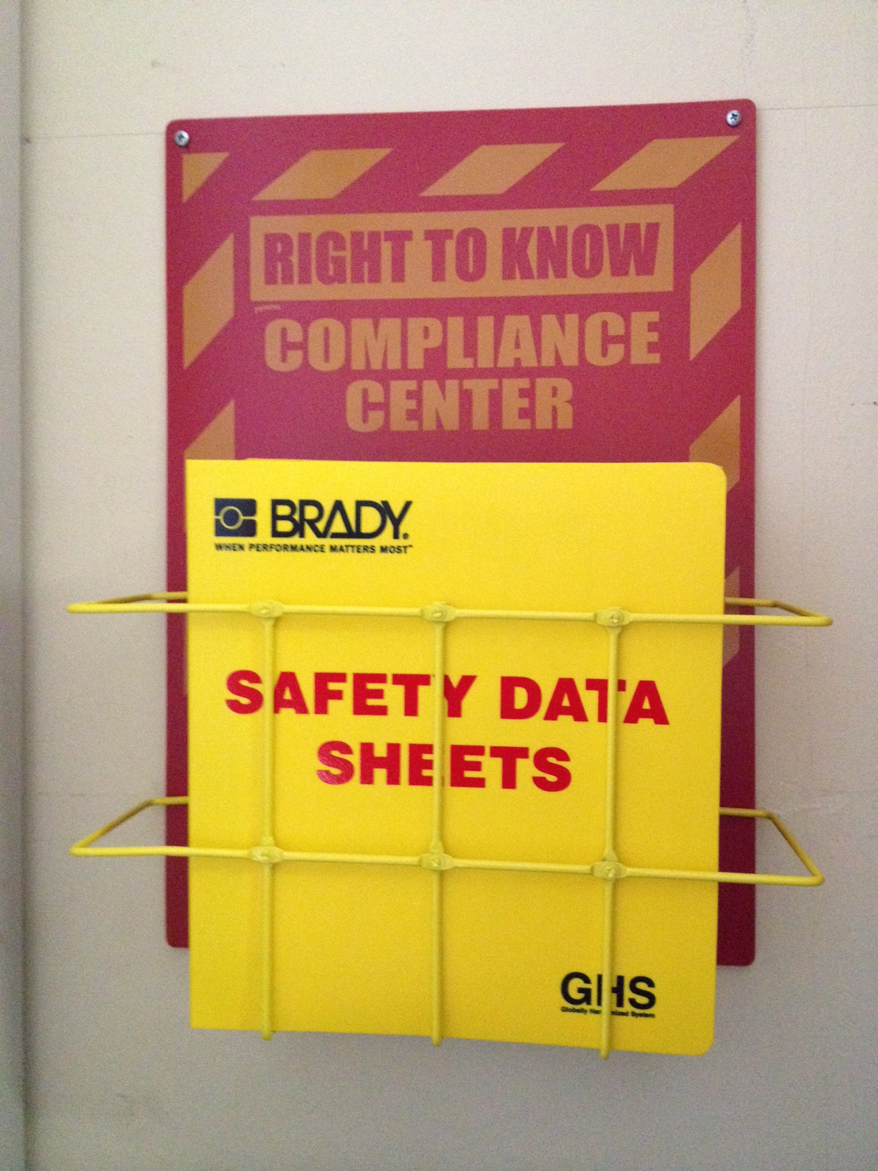
Know the Risks: Safety Data Sheets (SDS) Summary of information on a particular chemical including its hazardous nature
Each lab or classroom where chemicals are used has it's own site-specific set of SDSs
They can be found in clearly marked yellow binders located at a "Right to Know Compliance Center" or on a designated shelf (Plante Lab 205)
It is important to consult an SDS before working with hazardous substances or introducing a new chemical into a lab protocol
Use as a reference for accidents or spills

Slide 6
SDS Contents:
Category
Example
1. Product and company identification | Formalin, Sigma-Aldrich
2. Hazard identification | Flammable liquid Cat.4, pictograms
3. Composition (information on ingredients) | Formaldehyde, Methanol
4. First Aid measures | If exposed to skin…
5. Firefighting measures | Extinguisher type (CO2, foam)
6. Accidental release measures | Spill response
7. Handling and storage | Avoid skin contact, flammables cab.
8. Exposure Controls and Personal Protection | List PPE Required
9. Physical and chemical properties | Form, Odor, BP, FP, Relative density
10. Stability and reactivity | Conditions to avoid, incompatible materials
11. Toxicological information | Toxicity, Mutagenicity, Carcinogenicity
12. Ecological information | Toxicity, Persistence, Bioaccumulative
13. Disposal considerations | Waste treatment methods
14. Transport information | DOT regulations
15. Regulatory information | EPA Extremely Hazardous Substance list
16. Other information | NFPA Diamond

Slide 7
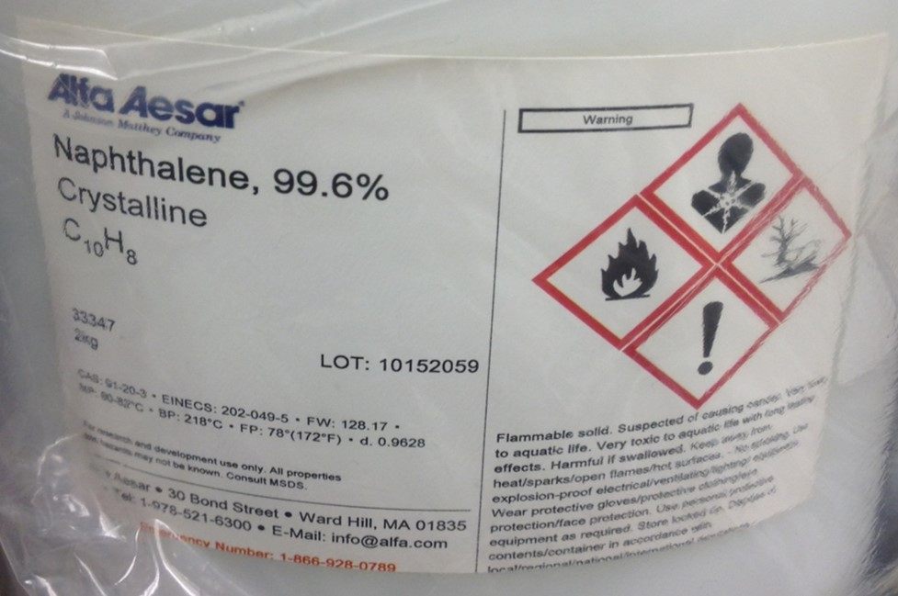
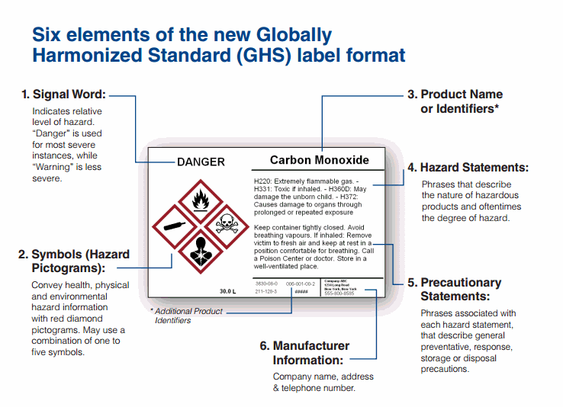
New GHS Labelling
1. Signal Word – Either “Warning” or “Danger”
2. Pictograms
3. Product Identifiers
4. Hazard Statements
5. Precautionary Statements
6. Manufacturer info

Slide 8
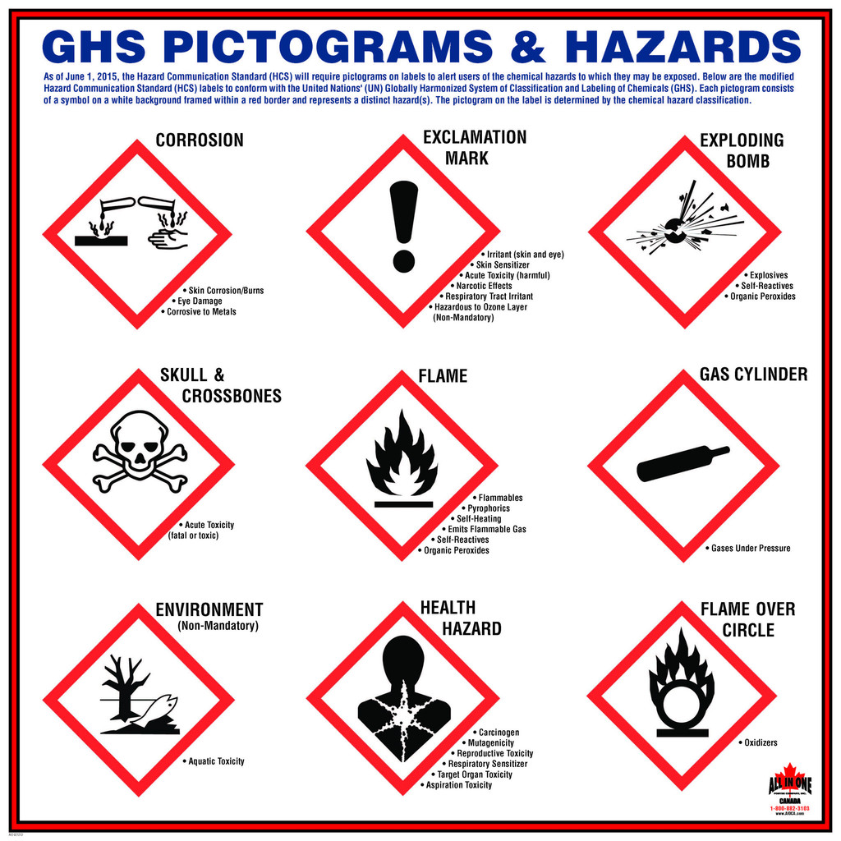
Hazard Communication Pictograms – communicates hazards to workers
Displayed in all labs

Slide 9
Know the Risks: The Hazard Communication Diamond
NFPA color coded rating system
Provides information to emergency responders
Found outside building, outside doors, on tanks
Frequently used in conjunction with GHS labeling
Risk type:
Blue=Health, Red=Flammability, Yellow=Reactivity,
White=Special Hazard
Risk indicators: 1=Minimal, 2=Slight, 3=Moderate, 4=Serious, 5=Extreme

Slide 10
Minimizing Risk
Standard operating procedures (SOPs)
Personal protective equipment (PPE)
Engineering controls
General lab rules and prudent practices
Chemical Hygiene Plan (CHP)

Slide 11
Minimizing Risk - Standard Operating Procedures (SOPs)
SOPs are written procedures directing how to safely work with hazardous materials
Lab-specific SOPs are required for any work with hazardous chemicals or any application of hazardous operations specific to the protocol
Developed by PI (principal investigator) or lab director
Follow them!
Notes:
Once risks are identified…

Slide 12
Minimizing Risk - PPE

Slide 13
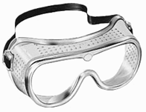
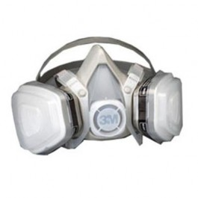
Minimizing Risk - Personal Protective Equipment
The supervisor, principal investigator or laboratory instructor is responsible for determining and clearly identifying which personal protective devices are required for each task performed by employees, students, and /or other type of personnel working on CofC property.
Safety glasses/goggles
Lab coats or other protective garments
Gloves – Nitrile most common. Latex no longer used
Mask/respirator – only when fitted and approved by EH&S
Ear plugs (workshop tools)
Notes:
Risks also minimized by…
The supervisor, principal investigator or laboratory instructor is responsible for determining and clearly identifying which personal protective devices are required for each task performed by employees, students, and /or other type of personnel working on College’s premises.

Slide 14
Rules for Glove Use:
Check gloves (even new ones) for physical damage.
Some gloves, especially lightweight disposables, may be flammable.
Avoid the contaminated exterior contacting the skin.
Dispose of contaminated gloves in proper container.
Do not attempt to re-use disposable gloves.
Never wear possibly contaminated gloves outside of the laboratory or to handle telephones, computer keyboards, etc.

Slide 15
Proper Glove Removal

Slide 16
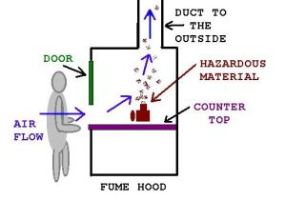
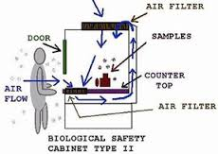
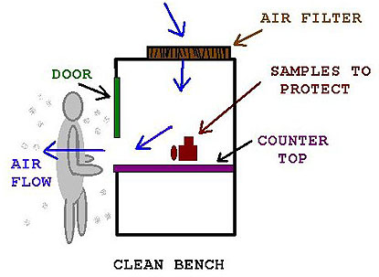
Minimizing Risk – Engineering Controls/Containment Devices
Chemical Fume Hood (210, 209, 205, 113)
Helps reduce exposure to hazardous liquids, vapors, dusts and mists
Biosafety Cabinet (Plante 205)
Provides personal and environmental protection from potentially infectious agents. HEPA filter and UV.
Moderate to High risk infectious agents (BSL2 and BSL3)
Clean Bench (MCF 210, Isaure’s lab)
Protects work material from contamination. HEPA filter and UV.
Notes:
HEPA – High Efficiency Particulate Air
Removes aerosols (dust, micro-organisms)
Horizontal Laminar Airflow – reduces turbulence and backwash

Slide 17
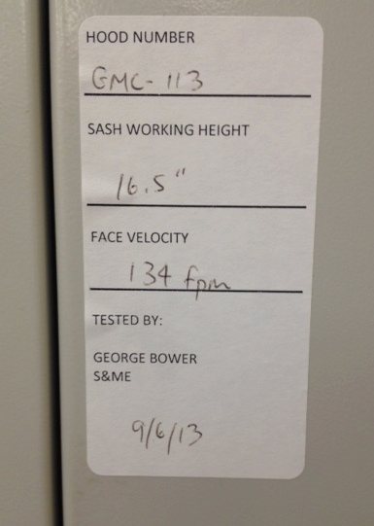
Chemical Fume Hood Use Rules
Use when required by SOP and SDS
Follow sash height stated on CFH certificate
Keep experiments
6-12” from front
1-2” from back
Don’t block slots/baffles
Keep sash down as far as possible and no higher than working height
Don’t overcrowd the bench surface
Notify Lab Manager of any Fume Hood problems

Slide 18
Minimizing Risk - General Lab Rules and Prudent Practices:
Closed toed shoes are required in labs (no flip flops)
Confine loose hair and clothing
No drinking or eating is allowed in the labs (209 designated area exception)
Always leave your work area clean and orderly
Never remove chemicals, biological samples, or laboratory equipment from a lab without proper authorization
Do not work alone in the laboratory if you are working with hazardous materials or equipment
Never leave an experiment unattended unless proper safety precautions are in place

Slide 20
Minimizing Risk - CofC Chemical Hygiene Plan (CHP)
The Occupational and Safety Health Administration (OSHA) requires that laboratory personnel be made aware of the CHP for their place of work.
The College EH&S Department develops and maintains a generic CHP to be used by the College's laboratories on all campuses and other related facilities.
All College affected personnel (faculty, staff, students etc.) should be familiar with the contents of the CHP and have continuous access to it.
Located with SDS binders
Lab workers are required to read the CHP and complete and return a copy of the CHP Awareness Certification.
Notes:
Read, sign form, turn in.

Slide 21
Types of Lab Hazards
Chemical
Biological
Radiological
Physical
Electrical
Mechanical

Slide 22
Chemical Hazards Chemical safety involves all phases of chemical use from procurement, storage, transportation, manipulation, decontamination and disposal.
Health Hazard (through inhalation, absorption, ingestion)
Corrosives – Hydrochloric acid
Carcinogens – Benzene, Formaldehyde
Sensitizers – Formaldehyde, Latex
Irritants – Ammonia, Formaldehyde
Mutagens – Acrylamide, Sodium azide
Toxins – Hydrogen sulfide, Formaldehyde
Physical Hazard
Flammables – Flashpoint below 100°F (Alcohols, Acetone, organics)
Combustibles – Flashpoint over 100°F (Ethylene glycol, Calcium)
Oxidizers – Hydrogen peroxide, Oxygen, Sulfuric acid
Identified by Pictograms
Notes:
Sensitizer – cause through an immune response, to become allergic to the chemical

Slide 23
Safe Chemical Handling

Slide 24
Chemical handling and storage
Use proper PPE
Do not store chemicals on the floor
Shelves and counters should be clean and not overcrowded
Label and date all chemicals (lab name, date received, date opened)
Pour liquids with the label facing up to prevent damage to the label
Never use abbreviations or scientific formulas when labeling chemicals
Always transport chemical in a secondary container
Work with the smallest amounts possible
Never smell or taste chemicals
Return chemicals to previous storage location

Slide 25
Working with Chemicals – Waste Disposal
NEVER pour chemicals down the drain
Label all chemical waste with name, date and concentrations of chemical involved
Leave container 10% empty for expansion
Notify supervisor or lab manager before waste container is 90% full

Slide 26
Chemical Spills
Understand spill control plan when working with hazardous chemicals
Have the appropriate spill control measures available
Notify personnel in the area
Isolate spill area
Never try to clean up a major spill
Small spills can be cleaned up with help from your supervisor or the lab manager
The mobile spill kit is located in the hall of the second floor
Notify your supervisor and the lab manager of all spills

Slide 27
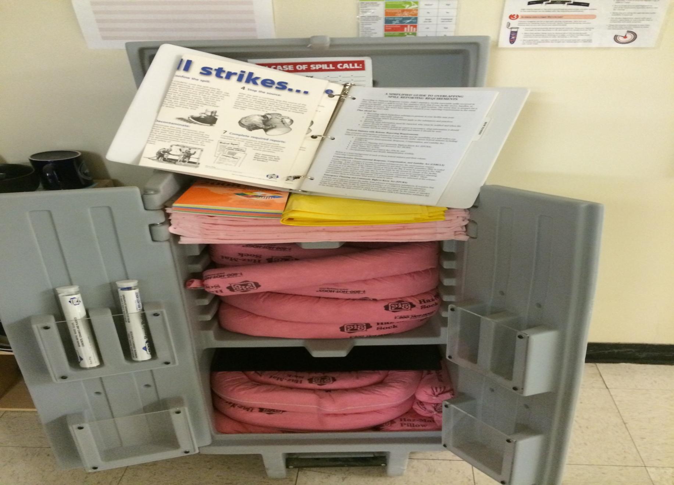
Second floor
Spill Kit
Outside of MCF 210

Slide 28
Biological Hazards
The term Biohazard is defined as:
An infectious agent or other hazardous biologic material that presents a risk or potential risk to the health of humans, animals, or the environment.
Biohazards include: certain types of recombinant DNA, organisms and viruses infectious to humans, animals, or plants (e.g., parasites, viruses, bacteria, fungi, prions, and rickettsia), and biologically active agents (e.g., toxins, allergens, and venoms)
Biohazards can cause disease in other living organisms or cause significant impact to the environment or community.

Slide 29
Biological Hazards
It is important to remember that all animal tissue and bodily fluids are a potential source of infection
Sources of biological hazards include bacteria, viruses, insects, plants (toxins and poisons), animals including marine organisms, and humans
These sources can cause a variety of health effects ranging from skin irritation, allergies, infections and worse
The biohazard symbol is used to indicate materials that carry a health risk
Your supervisor will inform you of any risk groups present in the lab you are working in
Notes:
Lets talk about other hazards in the lab…
International symbol for biological hazard
Used in the labeling of biological materials that carry a significant health risk

Slide 30
Risk Groups
RG1 – not infectious to healthy adults
RG2- generally agents that are transmitted via ingestion, through mucous membranes, and through the skin. The severity of disease is not as significant (usually) as high risk agents, and treatment is generally available. Mortality and morbidity is lower than high risk group classifications.
RG3-all routes of exposure are in play, especially the AIRBORNE route, severity in terms of morbidity and mortality are elevated and infectious dose is generally lower for RG3 agents. Treatment may/may not be available.
RG4- all routes of exposure, much more significant mortality/morbidity than RG3 agent, treatment usually not available.

Slide 31
Biological Safety When working with potentially infectious materials:
Follow SOPs
Wear personal protective equipment
Use a biosafety cabinet if procedures might generate aerosols (Do Not use a CFH when handling infectious agents)
Wash hands frequently after removing gloves and before exiting the lab
Disinfect work areas and equipment after use with appropriate disinfectant
Take special care when working with sharps (needles, Pasteur pipets, scalpels, capillary tubes)
Never eat, drink, smoke, handle contact lenses, apply cosmetics, or take medicine in a lab
Decontaminate and dispose of biological wastes properly
We encourage you to talk to the supervisor if you know you have a health condition that would put you at higher risk when working with potentially infectious materials ( i.e. immunosuppressed)

Slide 32
Radioactive Hazards
Reducing Exposure:
Time - Reduce time in areas containing radioactive materials
Distance - Keep your distance from radioactive materials
Shielding - Use proper shielding to reduce exposure if shielding is necessary
Observe signage
PPE
Proper storage and disposal
Training from CofC Rad training officer

Slide 33
Other Hazards
Electrical hazards
Compressed Gasses
Falls - Wet floors and Trip Hazards
Mechanical equipment (autoclave, centrifuge)
Power tools
UV lights (sunburns)

Slide 34
Electrical Safety
Do not overload outlets
Extension cords can only be used for a short-term temporary situation. Long term use of extension cords is an OSHA violation
Never double up (daisy chain) extension cords. Ensure the extension cord used is rated for the electrical current to be used
When working around water, always use a Ground Fault Circuit Interrupter (GFCI) outlet
Never handle electrical equipment when wet
Use caution when working around flammable liquids. Be aware of electrical ignition sources
Report faulty equipment to your supervisor or the lab manager immediately
If a breaker or GFCI trips, you should notify your supervisor or the lab manager immediately
Saltwater is a great conductor of electricity
All electrical connections in the wet lab must be approved by the Marine Operations Manager (Pete Meier)

Slide 35
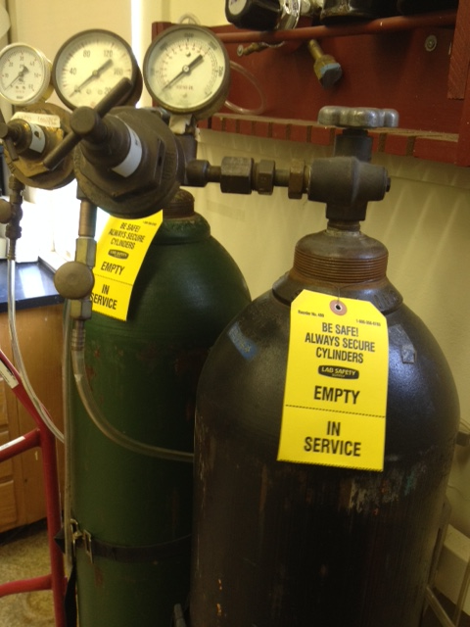
Compressed Gas Safety
All tanks must be secured above the center of gravity by approved supports
Ensure proper fitting of connections
Cylinders must be appropriately tagged
Cylinders in transit or not in use must be capped
Move only with appropriate cylinder cart

Slide 36
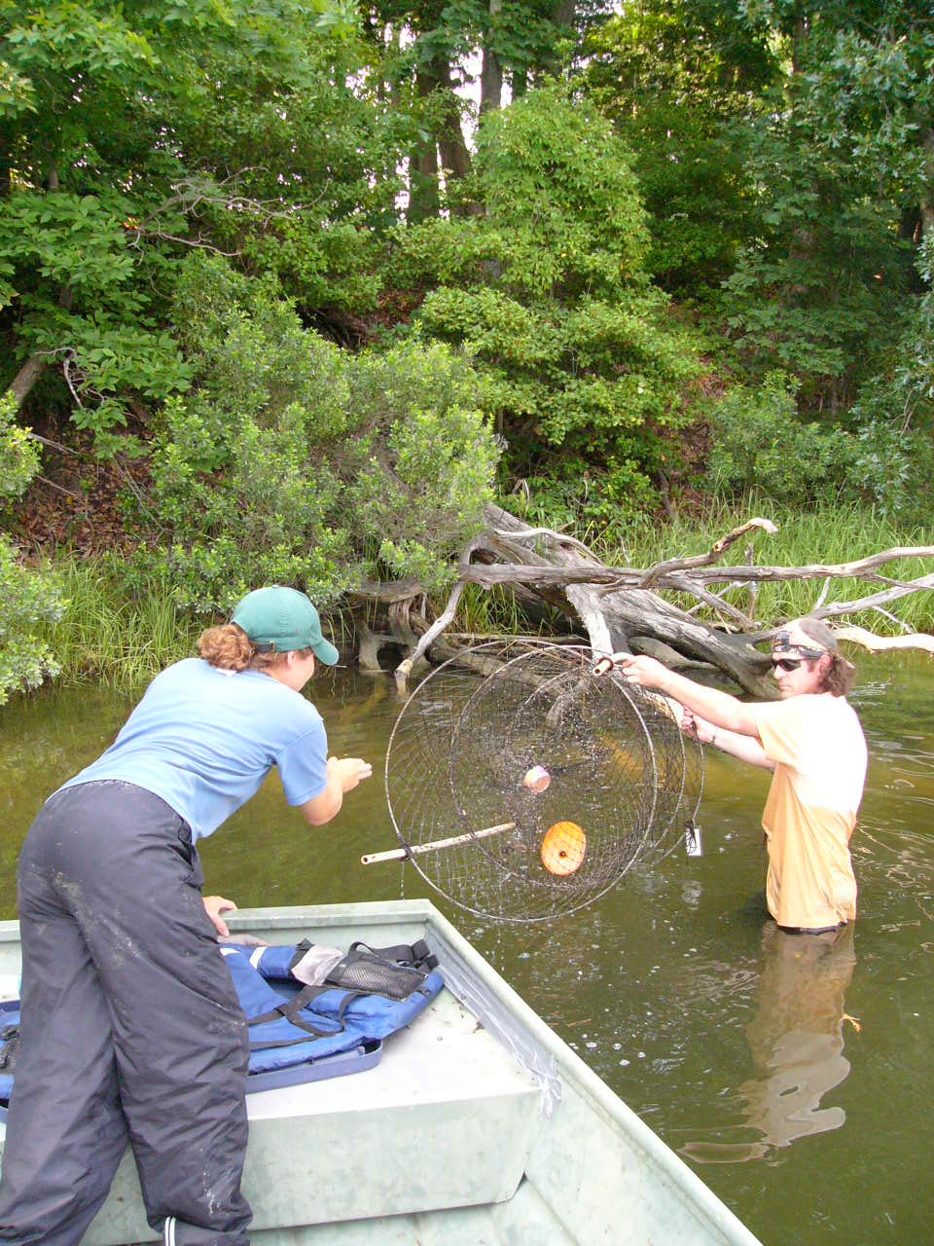
Safety in the Field
If possible, work with a partner.
Let someone know your itinerary – location, duration, contact info.
If using a boat or kayak, complete a float plan located outside of room 116 and submit it to Pete Meier (Marine Operations Manager).
Plan and prepare for health and safety problems that may occur in the field – hazardous plants, animals, terrain, equipment, and weather conditions.
Check out a fieldwork first aid kit from the Lab Manager (room 109).
If collecting living organisms, be sure someone in the group has a Collector’s Permit.
Follow SOPs if applicable.
Consider taking: PPE if necessary, sun protection, bug spray.

Slide 37
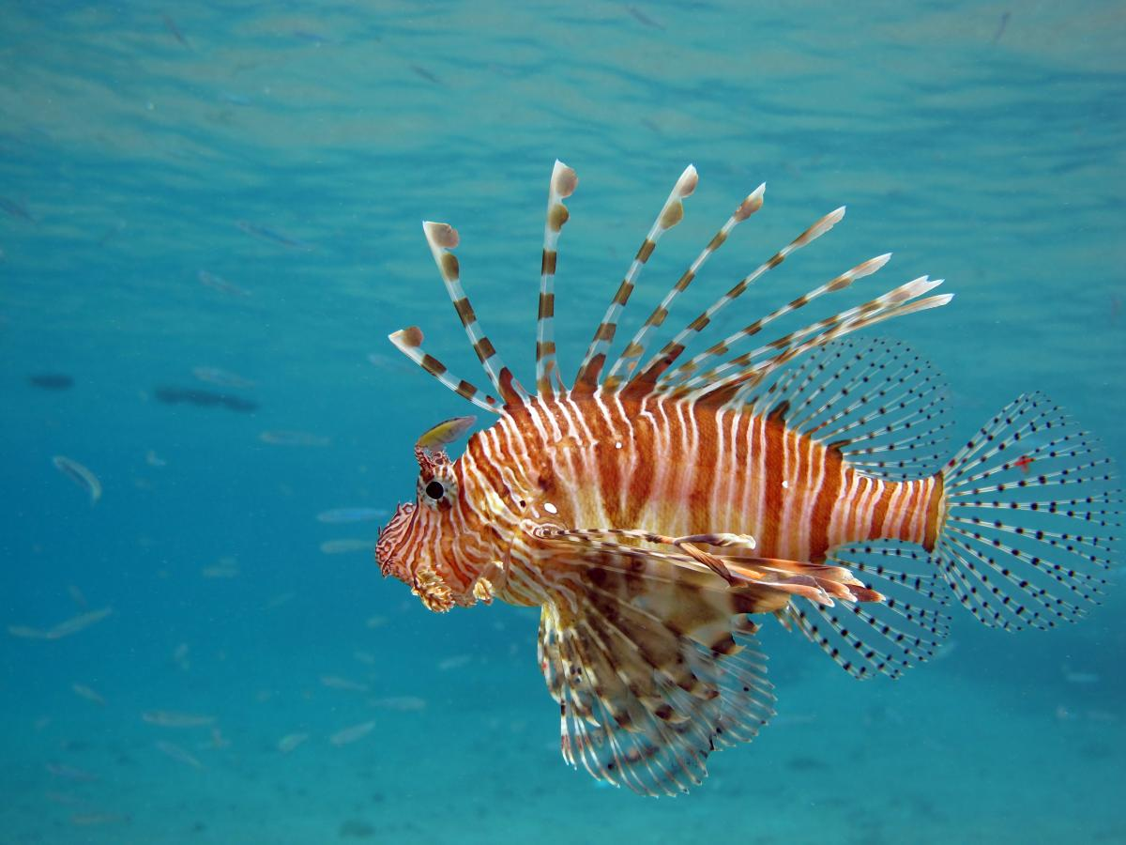
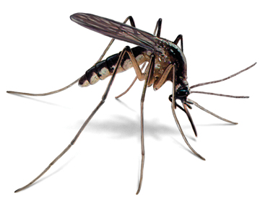
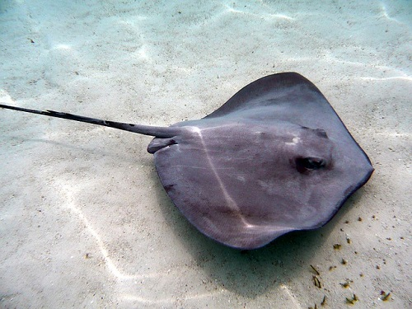
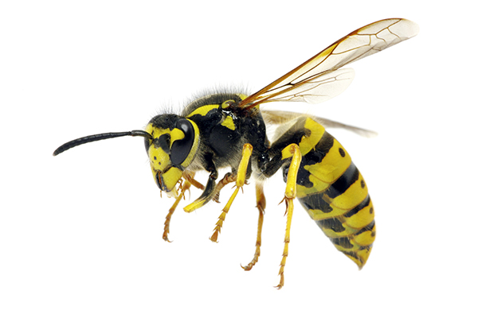
Types of Hazards Encountered in the Field
Environmental
Heat & cold, storms, lightning, tides.
Animals and Pests
Bites, stings
Diseases and Infections
Mosquitos and ticks
Oyster cuts
Microorganisms
Physical
Sunburn, injuries

Slide 38
Know what to do
in case of an accident or injury

Slide 39
GML Emergency Procedures and Contact Information Notice
Emergency Response Procedures
Notice contains:
Emergency procedures
Location of safety equipment
AED Unit (Defibrillator)
First Aid Kits
Important phone numbers
Notes:
Know the risks, minimized risks now….
Room Specific
Evacuation Procedure – Pull fire alarm, leave building via closest exit. Meet in parking area. Call 911.

Slide 41
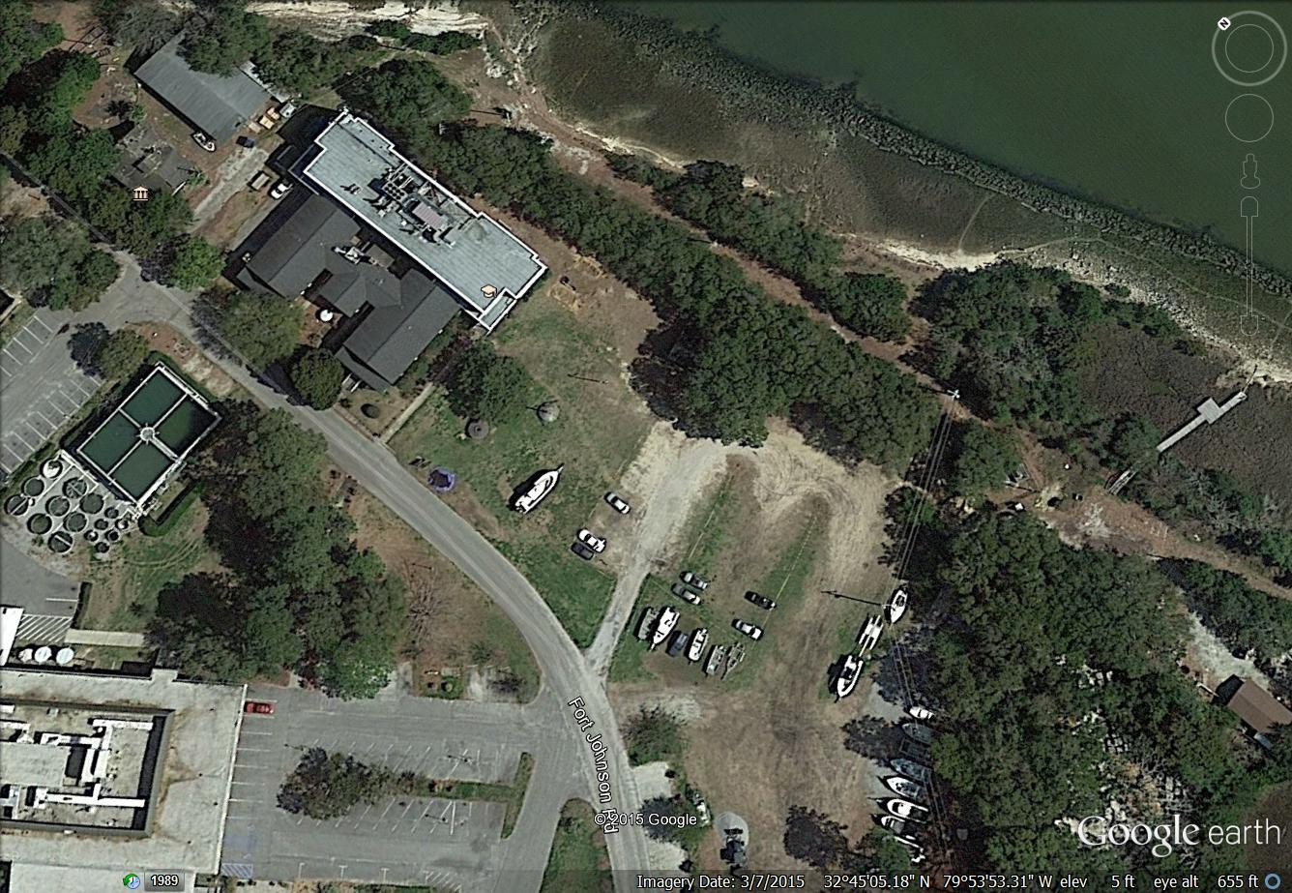
Grice
Evacuation
Area

Slide 42
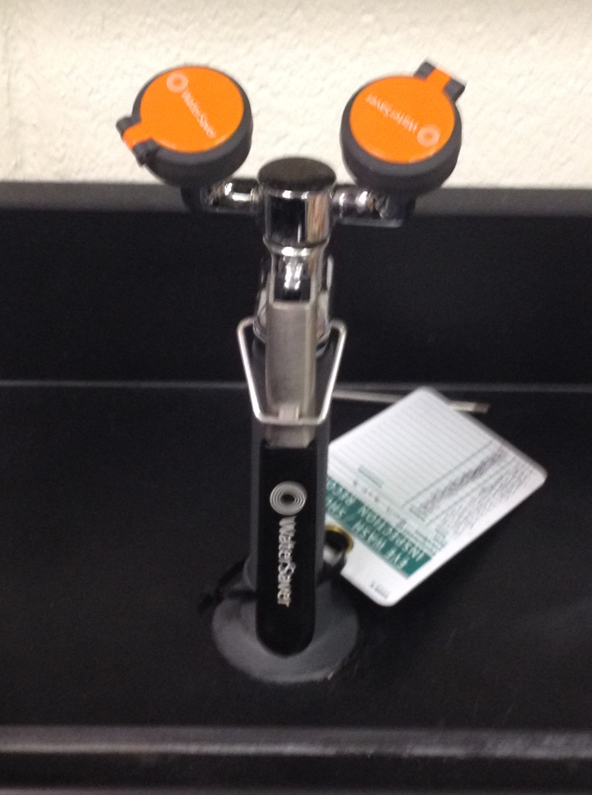
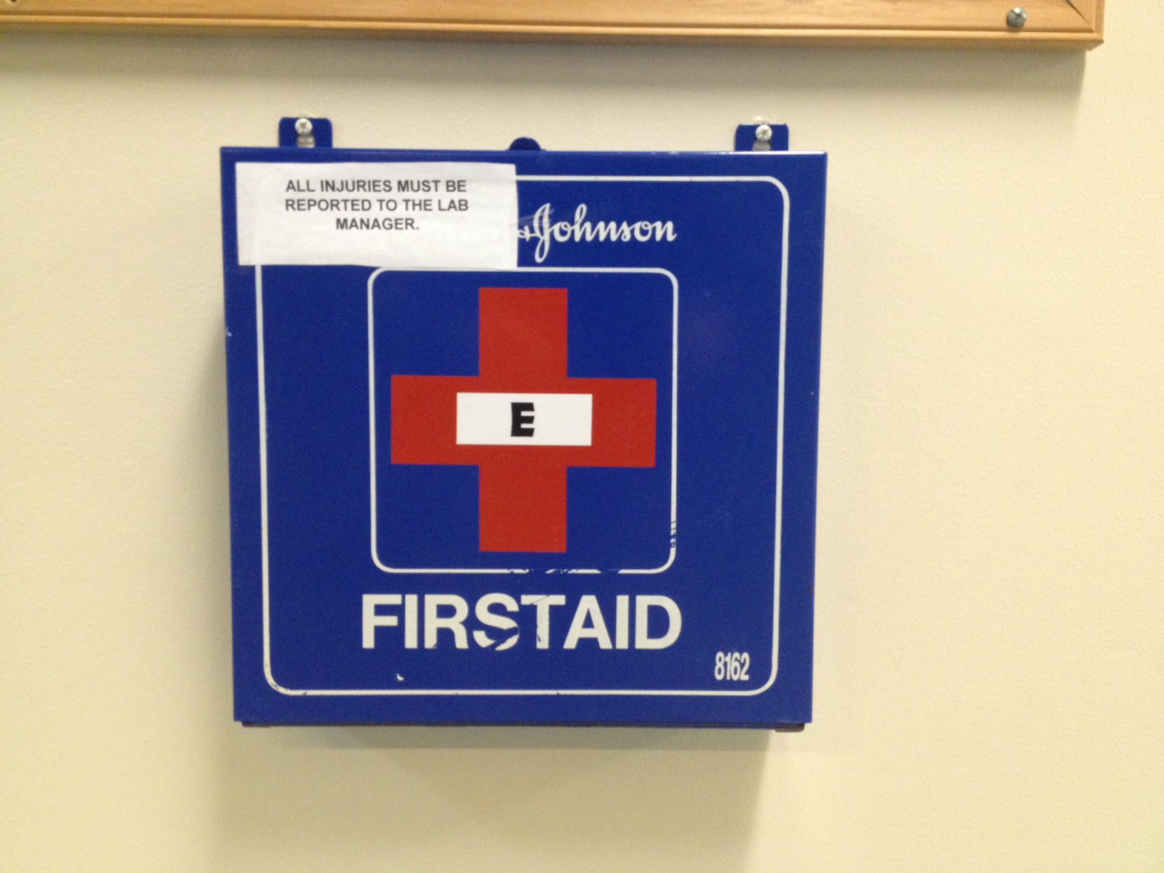
First Aid and Emergency Response Equipment Emergency Shower Eyewash Station First Aid Kit

Slide 43
AED –Automated External Defibrillator Located in main entrance stairwell An AED is a portable device that checks the heart rhythm and can send an electric shock to the heart to try to restore a normal rhythm. AEDs are used to treat sudden cardiac arrest - a condition in which the heart suddenly and unexpectedly stops beating.

Slide 44
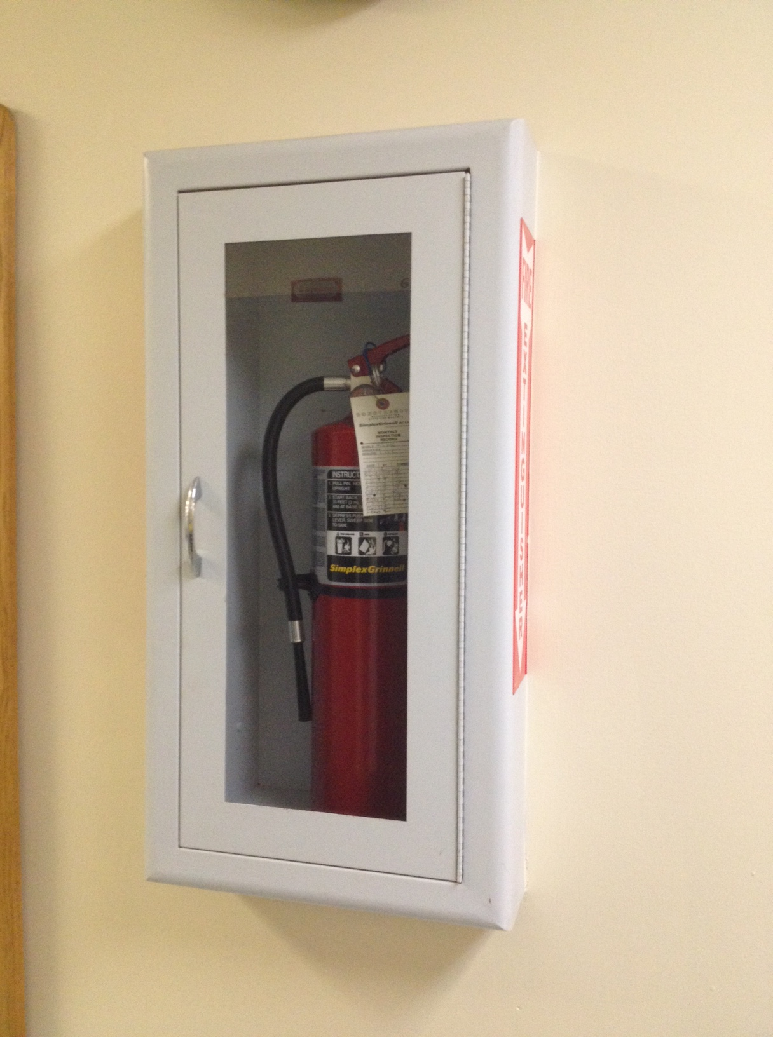
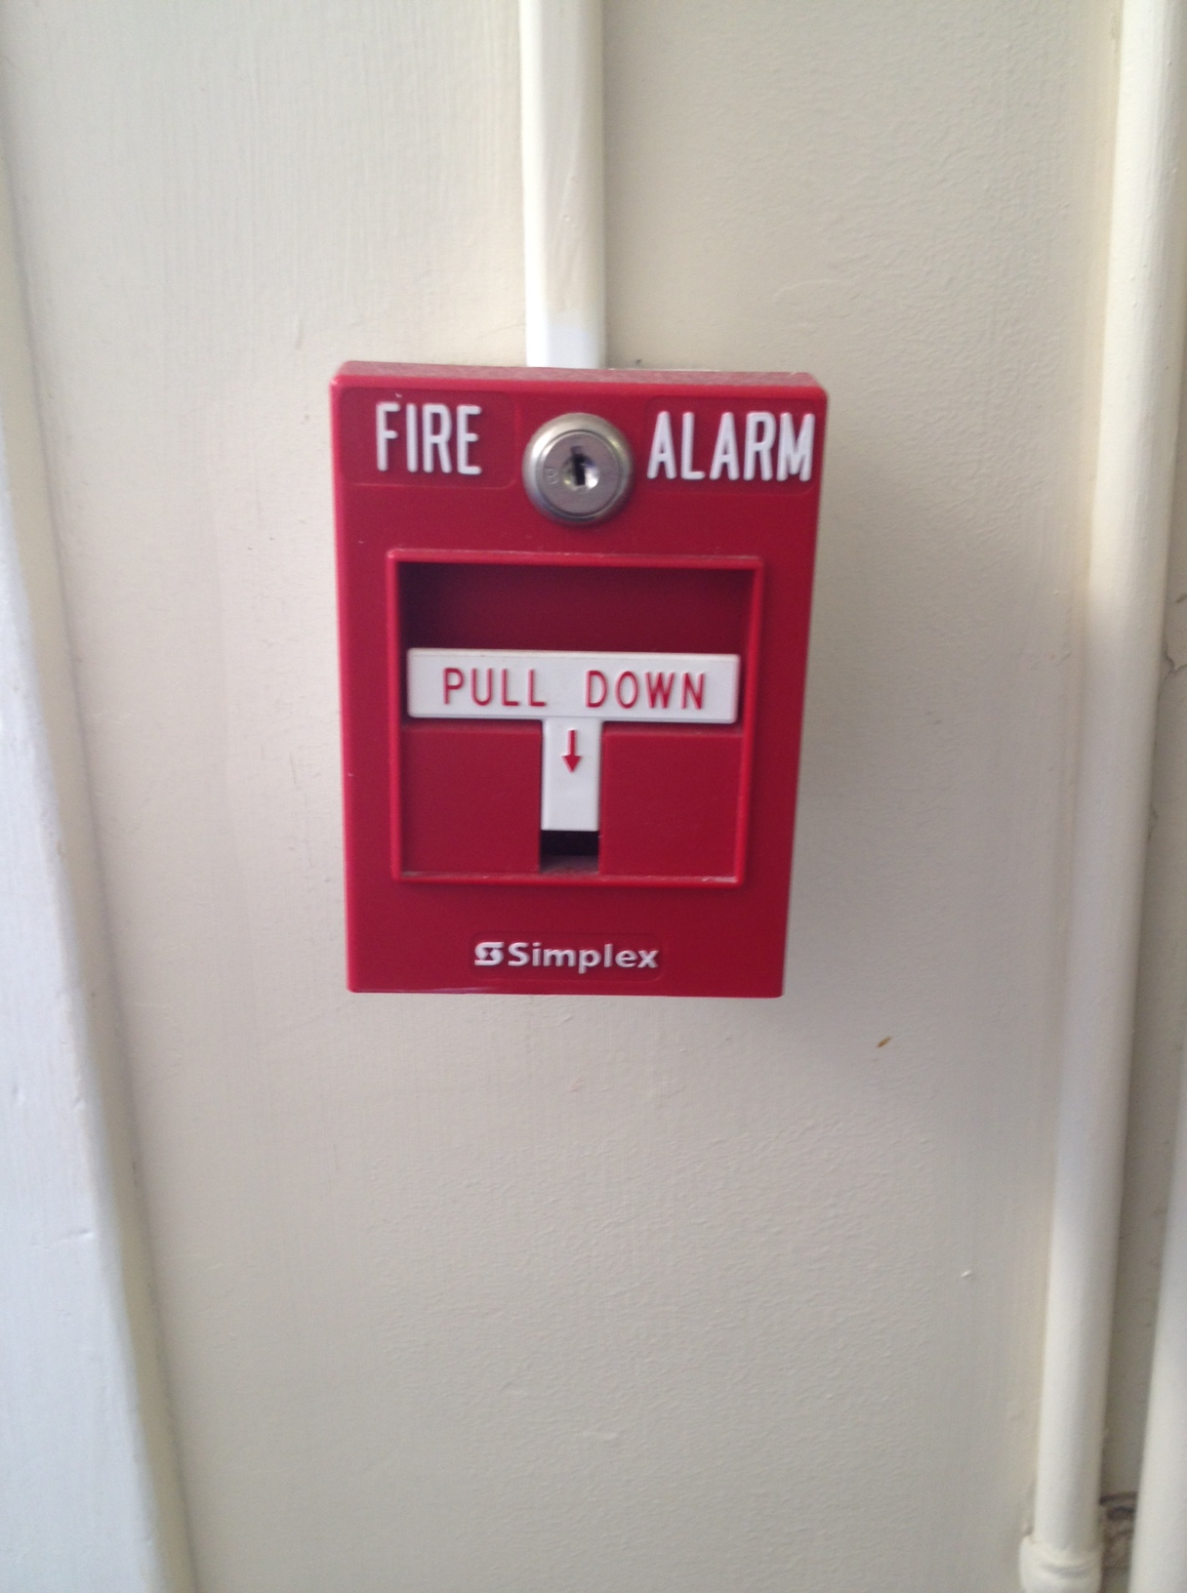
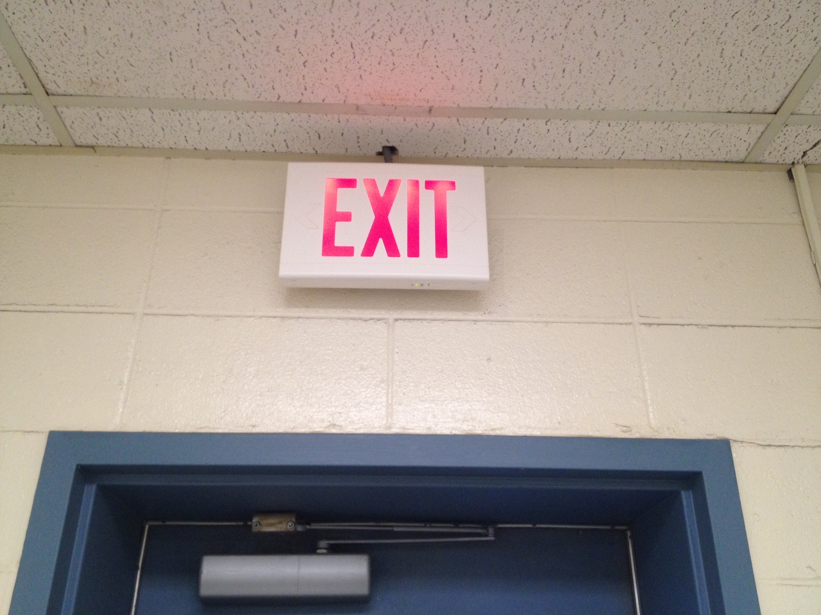
First Aid and Emergency Response Equipment
P. Pull the pin
A. Aim the extinguisher nozzle at the base of the fire
S. Squeeze trigger
S. Sweep the extinguisher from side to side (with back to exit)
Notes:
Fire Extinguisher Use
P. Pull the pin
A. Aim the extinguisher nozzle at the base of the fire
S. Squeeze trigger
S. Sweep the extinguisher from side to side

Slide 46
In Summation:
You are responsible for knowing the chemical, biological, electrical, mechanical and physical hazards associated with the materials and equipment being used in the laboratory you are working in.
Be aware of surroundings
Know the materials and equipment you are working with
Follow SOPs
Use appropriate personal protective equipment
Use appropriate engineering controls (CFH, BSC)
Know what to do and who to contact in case of accident or injury
If you are unsure or unclear about a procedure or task, let your supervisor know before attempting any work
Ask questions, express concerns, report hazards
Report accidents and injuries to your supervisor and/or the Lab Manager immediately
Remember: workplace Safety is a Shared Responsibility

Slide 47
Additional Information: gricemarinelab.cofc.edu

Slide 48
Additional Information: http://ehs.cofc.edu

Slide 49
Thank you!
…any questions?

